Slide 1
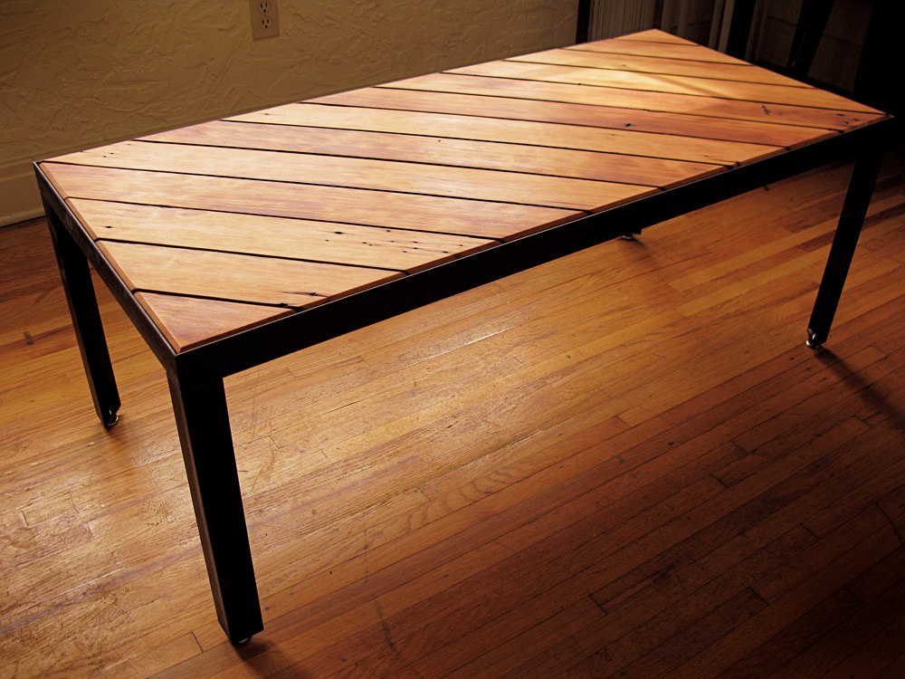
Optimizing Volume of a Table to Minimize Cost
By Devpreet Bhullar, Refayet Siam and Ryan Xu

Slide 2
Problem Definition
Table able to support a load of 5000 N of distributed load.
Factored maximum bending stress supported by the tabletop.
Factored buckling of the table legs.
Material chosen as Douglas fir wood.

Slide 3
Objective Function
Let $x_{1}=a,x_{2}=L_{l},x_{3}=b,x_{4}=h,x_{5}=L_{t}$
$minimize f\left(x_{1}, x_{2},x_{3},x_{4},x_{5}\right)=4x_{1}^{2}x_{2}+x_{3}x_{4}x_{5}$

Slide 4
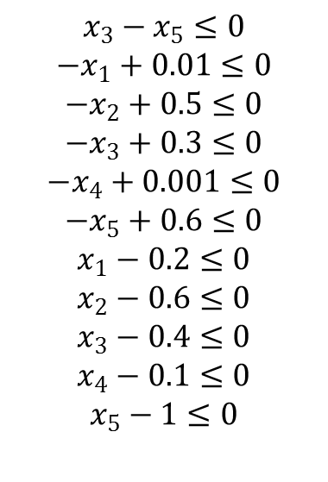
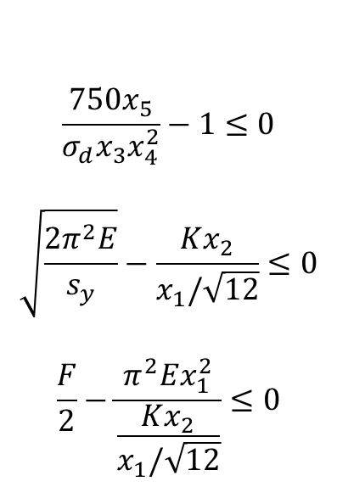
Constraints
$$\frac{750x_{5}}{σ_{d}x_{3}x_{4}^{2}}−1≤0$$
$$\sqrt{\frac{2π^{2}E}{s_{y}}}−\frac{Kx_{2}}{x_{1}/\sqrt{12}}≤0$$
$$\frac{F}{2}−\frac{π^{2}Ex_{1}^{2}}{\frac{Kx_{2}}{x_{1}/\sqrt{12}}}≤0$$
$$x_{3}−x_{5}≤0$$
$$−x_{1}+0.01≤0$$
$$−x_{2}+0.5≤0$$
$$−x_{3}+0.3≤0$$
$$−x_{4}+0.001≤0$$
$$−x_{5}+0.6≤0$$
$$x_{1}−0.2≤0$$
$$x_{2}−0.6≤0$$
$$x_{3}−0.4≤0$$
$$x_{4}−0.1≤0$$
$$x_{5}−1≤0$$

Slide 5
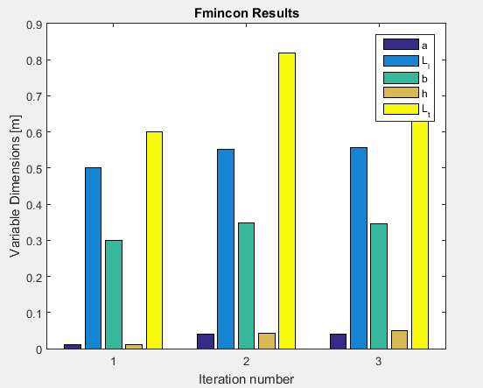
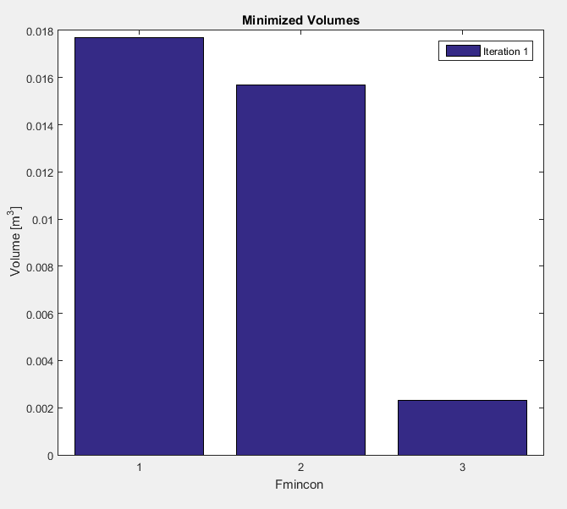
Results using ‘fmincon’ Solver
Starting value greatly affect fmincon results
Local minimum is found with all constraints satisfied.
Best fval is 0.0023
$$x_{0}$$ | $$x_{1}(a)$$ | $$x_{2}(L_{l})$$ | $$x_{3}(b)$$ | $$x_{4}(h)$$ | $$x_{5}(L_{t})$$ | $$f(x)$$
[0.01,0.3,0.2,0.05,0.5] | 0.0409 | 0.5559 | 0.3469 | 0.0501 | 0.8028 | 0.0177
[0.20,0.6,0.4,0.1,1] | 0.0400 | 0.5508 | 0.3471 | 0.0428 | 0.8194 | 0.0157
[0.01,0.5,0.3,0.001,0.6] | 0.0100 | 0.5008 | 0.3001 | 0.0114 | 0.6001 | 0.0023

Slide 6
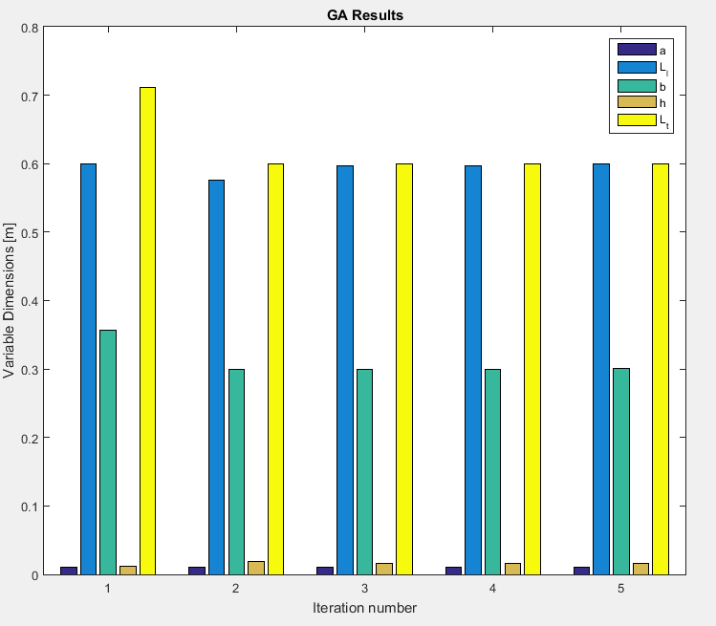
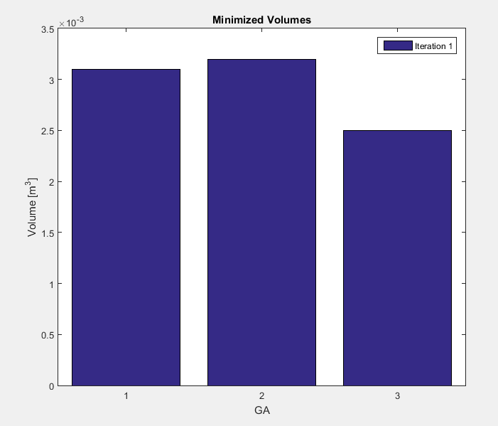
Results using GA Solver
Always minimizes towards global optimum
Numerous different iterations give similar minimized results
Best fval is 0.0025
Iteration/variable | $$x_{1}(a)$$ | $$x_{2}(L_{l})$$ | $$x_{3}(b)$$ | $$x_{4}(h)$$ | $$x_{5}(L_{t})$$ | $$f(x)$$
1 | 0.0100 | 0.6000 | 0.3569 | 0.0114 | 0.7109 | 0.0031
2 | 0.0100 | 0.5766 | 0.3000 | 0.0184 | 0.6000 | 0.0035
3 | 0.0100 | 0.5971 | 0.3000 | 0.0166 | 0.6000 | 0.0032
4 | 0.0100 | 0.5999 | 0.3134 | 0.0120 | 0.6054 | 0.0025
5 | 0.0102 | 0.5998 | 0.3006 | 0.0166 | 0.6002 | 0.0032

Slide 7
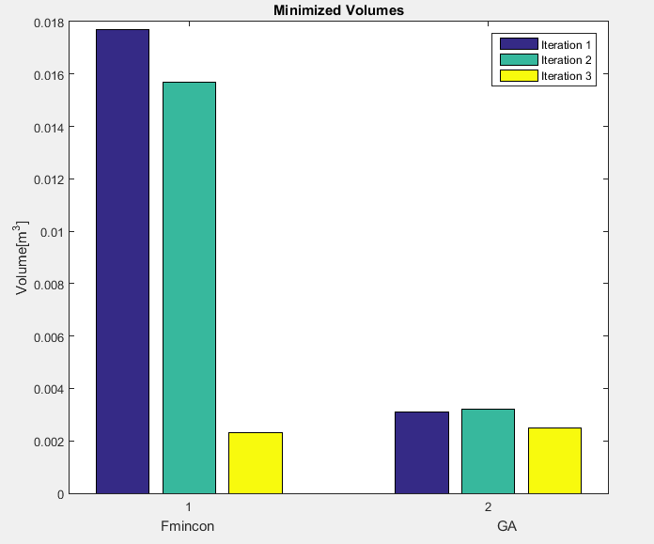
Comparison
Fmincon gives a better solution if the starting points are carefully selected
GA echoes results from Fmincon
Global optimum found
Solver | $$x_{1}(a)$$ | $$x_{2}(L_{l})$$ | $$x_{3}(b)$$ | $$x_{4}(h)$$ | $$x_{5}(L_{t})$$ | $$f(x)$$
Fmincon | 0.0100 | 0.5008 | 0.3001 | 0.0114 | 0.6001 | 0.0023
GA | 0.0100 | 0.5999 | 0.3134 | 0.0120 | 0.6054 | 0.0025

Slide 8
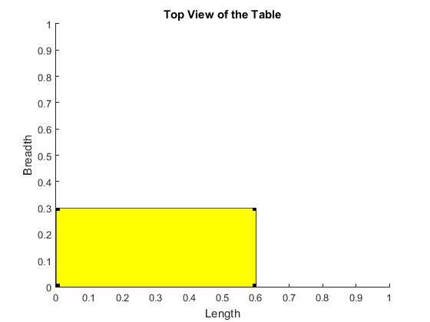
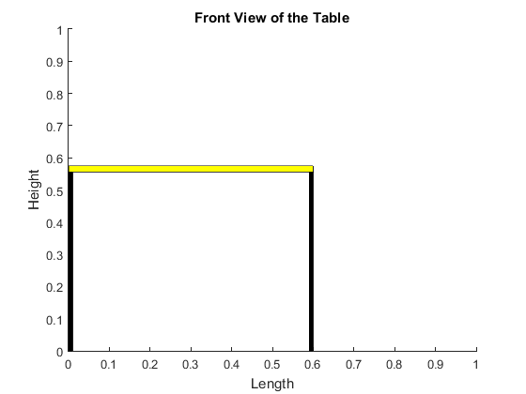
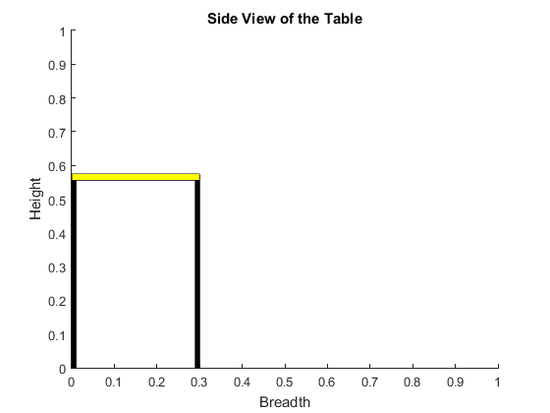
Final Design
Thin yet strong design
Optimization successfully found least material volume (0.0023 m³)
Withholds 5000 N of distributed load
*dimensions in meters

Slide 9
Thank you for your attention
Questions?

